Slide 1
Machine Learning
BCSML601
3:0:2

Slide 2
Pre- requisites
Linear Equations
Probability and Statistics
Graphs of Functions

Slide 3
Course Learning Objectives (CLO)
This course will enable students to,
Define machine learning and understand the basic theory underlying machine learning.
Differentiate supervised, unsupervised and reinforcement learning
Understand the basic concepts of learning and decision trees.
Understand neural networks and Bayesian techniques for problems appear in machine learning
Understand the instant based learning and statistical analysis of machine learning techniques.

Slide 4
MODULE 3
Artificial Neural Networks
Introduction,
Neural Network representation,
Perceptrons,
Backpropagation algorithm,
Remarks on the Backpropagation algorithm

Slide 5

Introduction
Artificial neural networks (ANNs) provide a general, practical method for learning real-valued, discrete-valued, and vector-valued functions from examples.
Algorithms such as BACKPROPAGATION use gradient descent to tune network parameters to best fit a training set of input-output pairs.
ANN learning is robust to errors in the training data and has been successfully applied to problems such as interpreting visual scenes, speech recognition, and learning robot control strategies.

Slide 6
Neural Network Representation
Artificial Neural Networks contain artificial neurons which are called units .
These units are arranged in a series of layers that together constitute the whole Artificial Neural Network in a system.
Artificial Neural Network has an input layer, an output layer as well as hidden layers.
The input layer receives data from the outside world which the neural network needs to analyze or learn about.
Then this data passes through one or multiple hidden layers that transform the input into data that is valuable for the output layer.
Finally, the output layer provides an output in the form of a response of the Artificial Neural Networks to input data provided.

Slide 7
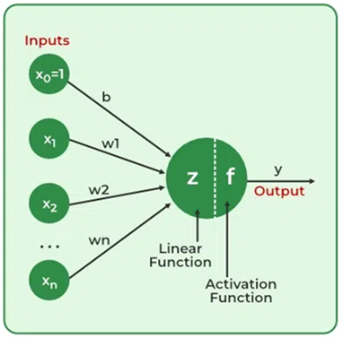
In the majority of neural networks, units are interconnected from one layer to another that is directed/undirected cyclic/acyclic graph.
Each of these connections has weights that determine the influence of one unit on another unit.
Learning corresponds to choosing a weight value for each edge in the graph.
As the data transfers from one unit to another, the neural network learns more and more about the data which eventually results in an output from the output layer.

Slide 8
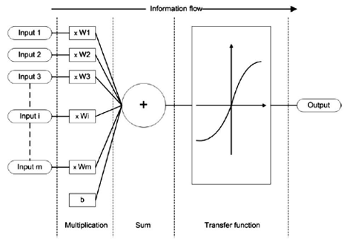
Basic building block of every artificial neural network is artificial neuron, that is, a simple mathematical model (function).
Such a model has three simple sets of rules: multiplication, summation and activation.
At the entrance of artificial neuron the inputs are weighted what means that every input value is multiplied with individual weight.
In the middle section of artificial neuron is sum function that sums all weighted inputs and bias.
At the exit of artificial neuron the sum of previously weighted inputs and bias is passing through activation function that is also called transfer function.

Slide 9
APPROPRIATE PROBLEMS FOR NEURAL NETWORK LEARNING
ANN learning is well-suited to problems in which the training data corresponds to noisy, complex sensor data, such as inputs from cameras and microphones.
It is appropriate for problems with the following characteristics:
Instances are represented by many attribute-value pairs. The target function to be learned is defined over instances that can be described by a vector of predefined features, such as the pixel values in the ALVINN example.
These input attributes may be highly correlated or independent of one another.
Input values can be any real values.
The target function output may be discrete-valued, real-valued, or a vector of several real- or discrete-valued attributes.
The training examples may contain errors - ANN learning methods are quite robust to noise in the training data.

Slide 10
Continue…
Long training times are acceptable. Network training algorithms typically require longer training times ranging from a few seconds to many hours, depending on factors such as the number of weights in the network, the number of training examples considered, and the settings of various learning algorithm parameters.
Fast evaluation of the learned target function may be required. Although ANN learning times are relatively long, evaluating the learned network, in order to apply it to a subsequent instance, is typically very fast.
The ability of humans to understand the learned target function is not important. The weights learned by neural networks are often difficult for humans to interpret.
Learned neural networks are less easily communicated to humans than learned rules.

Slide 11
PERCEPTRONS - Representation
One type of ANN system is based on a unit called a perceptron, shown in Figure.
Perceptron is a type of neural network that performs binary classification that maps input features to an output decision, usually classifying data into one of two categories.
A perceptron takes a vector of real-valued inputs, calculates a linear combination of these inputs, then outputs a 1 if the result is greater than some threshold and -1 otherwise

Slide 12
Continue…
More precisely, given inputs x₁ through x_{n} the output o(x₁, . . . , x_{n}) computed by the perceptron is
where each w_{i} is a real-valued constant, or weight, that determines the contribution of input x_{i} to the perceptron output
To simplify notation, consider an additional constant input x_{o} = 1, which makes the above inequality as or in vector form as
Thus the above equation can be written as
where

Slide 13
Learning a perceptron involves choosing values for the weights wo, . . . , w,.
Therefore, the space H of candidate hypotheses considered in perceptron learning is the set of all possible real-valued weight vectors.

Slide 14
Representational Power of Perceptrons
The perceptron is viewed as representing a hyperplane decision surface in the n-dimensional space of instances (i.e., points).
The perceptron outputs a 1 for instances lying on one side of the hyperplane and outputs a -1 for instances lying on the other side, as illustrated in Figure a.
Some sets of positive and negative examples that can be separated are called linearly separable sets of examples and some sets of positive and negative examples that cannot be separated by any hyperplane are linearly non separable.

Slide 15
The Perceptron - Training Rule
how to learn the weights for a single perceptron?
The precise learning problem is to determine a weight vector that causes the perceptron to produce the correct ±1 output for each of the given training examples.
The two Rules: the perceptron rule and the delta rule algorithms are guaranteed to converge to different acceptable hypotheses, under different conditions.
These rules are important to ANNs because they provide the basis for learning networks of many units.
To learn an acceptable weight vector,
begin with random initial weights,
then iteratively apply the perceptron to each training example,
modifying the perceptron weights whenever it misclassifies an example.
This process is repeated, iterating through the training examples as many times as needed until the perceptron classifies all training examples correctly.

Slide 16
Continue…
Weights are modified at each step according to the perceptron training rule
It revises the weight w_{i} associated with input x_{i} according to the rule w_{i} ← w_{i}+Δw_{i} where Δw_{i} = η (t - o) x_{i} , w_{i} is the initial value, Δw_{i} is the weight update added to initial weight
Here t is the true ground truth value of the dataset which is the target output for the current training example, o is the predicted value, the output generated by the perceptron, and η is a positive constant called the learning rate – how much of error is acceptable.
( t – o ) is the error and the role of the learning rate is to moderate the degree to which weights are changed at each step.
It is usually set to some small value (e.g., 0.1) and is sometimes made to decay as the number of weight-tuning iterations increases.

Slide 17
For example, if x_{i} > 0, then increasing w_{i} will bring the perceptron closer to correctly classifying this example.
Notice the training rule will increase w_{i}, in this case, because (t - o), η, and X_{i} are all positive.
For example, if x_{i} = .8, η = 0.1, t = 1, and o = - 1, then the weight update will be Δw_{i} = η(t - o)x_{i} = 0.1(1 - (-1))0.8 = 0.16.
On the other hand, if t = -1 and o = 1, then weights associated with positive x_{i} will be decreased to -0.16 rather than increased.

Slide 18
The above learning procedure can be proven to converge within a finite number of applications of the perceptron training rule to a weight vector that correctly classifies all training examples, provided the training examples are linearly separable and provided a sufficiently small η is used
If the data are not linearly separable, convergence is not assured.
Then what?

Slide 19
The Delta Rule – gradient descent
A second training rule, called the delta rule, is designed to overcome this difficulty of converging non linearly separable examples.
If the training examples are not linearly separable, the delta rule converges toward a best-fit approximation to the target concept.
The key idea behind the delta rule is to use gradient descent to search the hypothesis space of possible weight vectors to find the weights that best fit the training examples.
This rule is important because gradient descent provides the basis for the BACKPROPAGATION algorithm, which can learn networks with many interconnected units.
It is also important because gradient descent is the basis for learning algorithms that must search through hypothesis spaces containing many different types of continuously parameterized hypotheses.

Slide 20

Gradient Decent

Slide 21
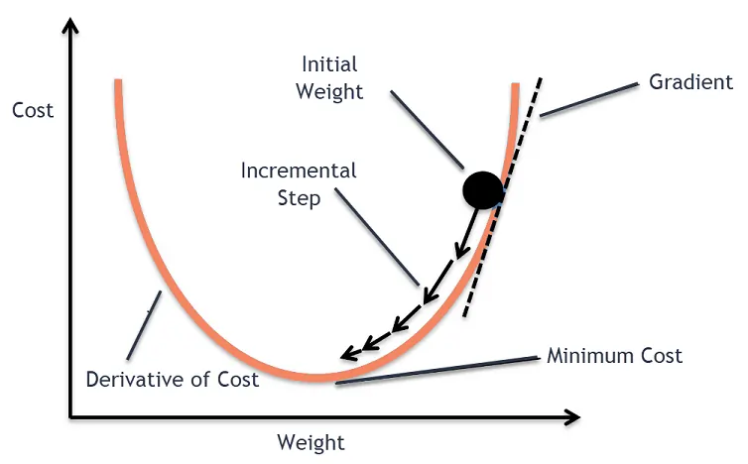
Gradient Descent
Cost Function quantifies the error between predicted values and expected values and presents it in the form of a single real number and in every iteration the cost has to be minimized

Slide 22
Consider the task of training an unthresholded perceptron; that is, a linear unit for which the output o is given by
o = w₀ + w₁x₁ + w₂x₂ + … + w_{n}x_{n} ➔
There’s an error function to learn w_{i} given as
where D is the set of training examples, t_{d} is the true value of one of the training data d, and o_{d} is the output of the linear unit ( perceptron) for training data d.
By this definition, E(w) is half the squared difference between the target output t_{d} and the linear unit output o_{d} , summed over all training examples d in D
Note: In perceptron Training rule o is either 1 or -1 for binary classification

Slide 23
VISUALIZING THE HYPOTHESIS SPACE
To understand the gradient descent algorithm, visualize the entire hypothesis space of possible weight vectors and their associated E values, as illustrated in Figure.
The axes w_{o} and w₁ represent possible values for the two weights of a simple linear unit.
The w_{o}, w₁ plane therefore represents the entire hypothesis space.
The vertical axis indicates the error E relative to some fixed set of training examples.

Slide 24
The error surface shown in the figure thus summarizes the desirability of every weight vector in the hypothesis space (desired hypothesis is with minimum error).
Given the way in which we chose to define E, for linear units this error surface must always be parabolic with a single global minimum.
The specific parabola will depend, of course, on the particular set of training examples.

Slide 25
Gradient descent search determines a weight vector that minimizes E by starting with an arbitrary initial weight vector, then repeatedly modifying it in small steps.
At each step, the weight vector is altered in the direction that produces the steepest descent along the error surface depicted in Figure
This process continues until the global minimum error is reached.

Slide 26
DERIVATION OF THE GRADIENT DESCENT RULE- weight update rule
How can we calculate the direction of steepest descent along the error surface?
This direction can be found by computing the derivative of E with respect to each component of the vector w.
This vector derivative is called the gradient of E with respect to
The Gradient descent update consists of a partial derivation of the error function with respect to each weight w_{i} as shown below:
Now we have, the update weight vector
where η is a positive constant called the learning rate, which determines the step size in the gradient descent search.
The negative sign is present because we want to move the weight vector in the direction that decreases E

Slide 27
This training rule can also be written in its component form
where weight update for each w_{i} is
Which means that steepest descent is achieved by altering each component w_{i} of in proportion to

Slide 28
The vector of derivatives that form the gradient can be obtained by
differentiating E from Equation as
WKT, , so,

Slide 29
Since, we are only differentiating with respect to w_{i} , all the other w’s of
o = w₀ + w₁x_{1d} + w₂x_{2d} + … w_{i}x_{id} + … + w_{n}x_{nd} are constants in this
differentiation
So the only element that matters is w_{i}x_{id} and when differentiated we get the co-efficient x_{id} , and therefore we get
The equation gives in terms of the linear unit inputs x_{id} , the outputs o_{d}, and target values t_{d} associated with the training examples.
Substituting the above Equation into Equation
yields the weight update rule for gradient descent

Slide 30
Perceptron logic function – AND gate
Perceptron can model basic logic gates like AND, OR and NOT
Example: Perceptron for AND gate
Given the training examples (x₁, x₂) , Perceptron equation y = step(w₁x₁ + w₂x₂ + b), this step function outputs 1 if the sum is >= 0 and 0 otherwise. Find w₁, w₂, and b
x1 | x2 | y | AND
0 | 0 | b | 0
0 | 1 | w₂ + b | 0
1 | 0 | w₁ + b | 0
1 | 1 | w₂ + w₂ + b | 1

Slide 31
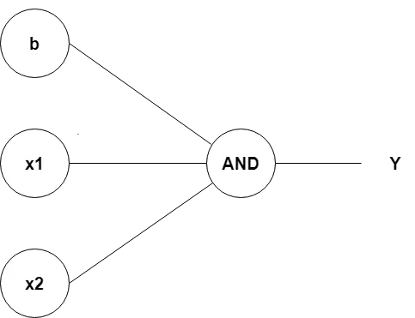
x1 | x2 | y | Step function OUTPUT
0 | 0 | -1.5 | 0
0 | 1 | -0.5 | 0
1 | 0 | -0.5 | 0
1 | 1 | 0.5 | 1
To satisfy these conditions:
b < 0
w₁ + b < 0 and w₂ + b < 0
w₁ + w₂ + b >= 0
Choose w₁ =1 w₂ = 1 and b = -1.5
Thus, ( 1, 1, -1.5) works for AND gate
-1.5
w₁=1
w₂=1

Slide 32
Perceptron logic function- OR gate
Example: Perceptron for OR gate
Given the Perceptron equation y = step(w₁x₁ + w₂x₂ + b), this step function outputs 1 if the sum is >= 0 and 0 otherwise. Find w₁, w₂, and b
x1 | x2 | y | OR
0 | 0 | b | 0
0 | 1 | w₂ + b | 1
1 | 0 | w₁ + b | 1
1 | 1 | w₁ + w₂ + b | 1

Slide 33
To satisfy these conditions:
b < 0
w₁ + b >= 0 and w₂ + b >= 0
w₁ + w₂ + b >= 0
Choose w₁ =1 w₂ = 1 and b = -0.5
Thus, ( 1, 1, -0.5) works for OR gate
x1 | x2 | y | Step function OUTPUT
0 | 0 | -0.5 | 0
0 | 1 | 0.5 | 1
1 | 0 | 0.5 | 1
1 | 1 | 1.5 | 1

Slide 34
Perceptron logic function – NOR gate
Example: Perceptron for NOR gate
Given the Perceptron equation y = step(w₁x₁ + w₂x₂ + b), this step function outputs 1 if the sum is >= 0 and 0 otherwise. Find w₁, w₂, and b
x1 | x2 | y | NOR
0 | 0 | b | 1
0 | 1 | w₂ + b | 0
1 | 0 | w₁ + b | 0
1 | 1 | w₁ + w₂ + b | 0

Slide 35
To satisfy these conditions:
b >= 0
w₁ + b < 0 and w₂ + b < 0
w₁ + w₂ + b < 0
Choose w₁ = -1 w₂ = -1 and b = 0.5
Thus, ( -1, -1, 0.5) works for NOR gate
x1 | x2 | y | Step function OUTPUT
0 | 0 | 0.5 | 1
0 | 1 | -0.5 | 0
1 | 0 | -0.5 | 0
1 | 1 | -1.5 | 0

Slide 36
Perceptron logic function – XOR gate
Example: Perceptron for XOR gate – Not possible
Given the Perceptron equation y = step(w₁x₁ + w₂x₂ + b), step function outputs 1 if the sum is >= 0 and 0 otherwise.
To satisfy these conditions:
b < 0
0 + w₂ + b >= 0
w₁ + 0 + b >= 0
w₁ + w₂ + b < 0
Since, XOR function requires 2 different decision boundaries, single perceptron is not sufficient
That is., Since they are not linearly separable, no single equation can separate these points - Solution → Multilayer perceptron - 3 perceptrons
x1 | x2 | y | XOR
0 | 0 | b | 0
0 | 1 | w₂ + b | 1
1 | 0 | w₁ + b | 1
1 | 1 | w₁ +w₂+ b | 0

Slide 37
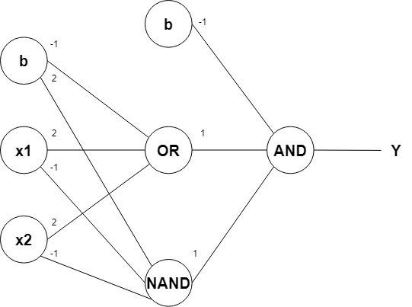
Multilayer Perceptrons – XOR gate

Slide 38
Where is the learning happening?
Example: Training a Perceptron to learn the AND gate using Perceptron Learning
Given the activation function y’ = step(w₁x₁ + w₂x₂ + b),
Where the step function is
step(z) = 1, if z>= 0
0, otherwise
Find w₁, w₂, and bias b for the AND gate function

Slide 39
Step1: Define the AND gate truth table:
Step2: Given the activation function
y’ = step(w₁x₁ + w₂x₂ + b),
Initialize weights and Bias
w₁ =0, w₂ = 0, b = 0
Also define the learning rate η = 1
Step3: Use Perceptron Learning Rule to update
weights and bias -
w_{i} ← w_{i} + η ( y – y’) . x_{i} y - target output, y’ – perceptron’s predicted output
b ← b + η ( y – y’)
x₁ | x₂ | y Target o/p
0 | 0 | 0
0 | 1 | 0
1 | 0 | 0
1 | 1 | 1

Slide 40
Epoch 1: First iteration on training data
Updated weights after Epoch1 : w₁ = 1, w₂ = 1, b = 0
x₁ | x₂ | y | z = w₁x₁ + w₂x₂ + b | y’ = step(z) | Update rule( if y and y’ are different)
0 | 0 | 0 | 0 + 0 + 0 = 0 | 1 | w₁ = 0 + (1 x (0-1)) x 0 = 0 w₂ = 0 + (1 x (0-1)) x 0 = 0 b = 0 + (1 x (0-1)) = -1
0 | 1 | 0 | 0 + 0 + (-1) = -1 | 0 | No Update ( y and y’ same)
1 | 0 | 0 | 0 + 0 + (-1) = -1 | 0 | No Update ( y and y’ same)
1 | 1 | 1 | 0 + 0 + (-1) = -1 | 0 | w₁ = 0 + (1 x (1-0)) x 1 = 1 w₂ = 0 + (1 x (1-0)) x 1 = 1 b = -1 + (1 x (1-0)) = 0

Slide 41
Epoch 2: Second iteration on training data – checking for errors
Updated weights after Epoch2 : w₁ = 2, w₂ = 1, b = -1
x₁ | x₂ | y | w₁x₁ + w₂x₂ + b = z | y’ = step(z) | Update rule( if y and y’ are different)
0 | 0 | 0 | 1(0) + 1(0) + 0 = 0 | 1 | w₁ = 1 + (1 x (0-1)) x 0 = 1 w₂ = 1 + (1 x (0-1)) x 0 = 1 b = 0 + (1 x (0-1)) = -1
0 | 1 | 0 | 1(0) +1(1) + (-1) = 0 | 1 | w₁ = 1 + (1 x (0-1)) x 0 = 1 w₂ = 1 + (1 x (0-1)) x 1 = 0 b = -1 + (1 x (0-1)) = -2
1 | 0 | 0 | 1(1) + 0(0) + (-2) = -1 | 0 | No Update ( y and y’ same)
1 | 1 | 1 | 1(1) + 0(1) + (-2) = -1 | 0 | w₁ = 1 + (1 x (1-0)) x 1 = 2 w₂ = 0 + (1 x (1-0)) x 1 = 1 b = -2 + (1 x (1-0)) = -1

Slide 42
Epoch 3: Third iteration on training data – checking for errors
Updated weights after Epoch3 : w₁ = 2, w₂ = 2, b = -2
x₁ | x₂ | y | w₁x₁ + w₂x₂ + b = z | y’ = step(z) | Update rule( if y and y’ are different)
0 | 0 | 0 | 2(0) + 1(0) + -1 = 1 | 1 | w₁ = 2 + (1 x (0-1)) x 0 = 2 w₂ = 1 + (1 x (0-1)) x 0 = 1 b = -1 + (1 x (0-1)) = -2
0 | 1 | 0 | 2(0) +1(1) + (-2) = -1 | 0 | No update
1 | 0 | 0 | 2(1) + 1(0) + (-2) = 0 | 1 | w₁ = 2 + (1 x (0-1)) x 1 = 1 w₂ = 1 + (1 x (0-1)) x 0 = 1 b = -2 + (1 x (0-1)) = -3
1 | 1 | 1 | 1(1) + 1(1) + (-3) = -1 | 0 | w₁ = 1 + (1 x (1-0)) x 1 = 2 w₂ = 1 + (1 x (1-0)) x 1 = 2 b = -3 + (1 x (1-0)) = -2

Slide 43
Epoch 4: forth iteration on training data – checking for errors
Updated weights after Epoch4 : w₁ = 3, w₂ = 2, b = -2
x₁ | x₂ | y | w₁x₁ + w₂x₂ + b = z | y’ = step(z) | Update rule( if y and y’ are different)
0 | 0 | 0 | 2(0) +2(0) + (-2) = -2 | 0 | No update
0 | 1 | 0 | 2(0) +2(1) + (-2) = 0 | 1 | w₁ = 2 + (1 x (0-1)) x 0 = 2 w₂ = 2 + (1 x (0-1)) x 1 = 1 b = -2 + (1 x (0-1)) = -3
1 | 0 | 0 | 2(1) + 1(0) + (-3) = -1 | 0 | No update
1 | 1 | 1 | 1(1) + 1(1) + (-3) = -1 | 0 | w₁ = 2 + (1 x (1-0)) x 1 = 3 w₂ = 1 + (1 x (1-0)) x 1 = 2 b = -3 + (1 x (1-0)) = -2

Slide 44
Epoch 5: fifth iteration on training data – checking for errors
Updated weights after Epoch5 : w₁ = 1, w₂ = 2, b = -3
x₁ | x₂ | y | w₁x₁ + w₂x₂ + b = z | y’ = step(z) | Update rule( if y and y’ are different)
0 | 0 | 0 | 3(0) +2(0) + (-2) = -1 | 0 | No update
0 | 1 | 0 | 3(0) +2(1) + (-2) = 0 | 1 | w₁ = 3 + (1 x (0-1)) x 0 = 3 w₂ = 2 + (1 x (0-1)) x 1 = 1 b = -2 + (1 x (0-1)) = -3
1 | 0 | 0 | 3(1) + 1(0) + (-3) = 0 | 1 | w₁ = 3 + (1 x (0-1)) x 1 = 0 w₂ = 1 + (1 x (0-1)) x 0 = 1 b = -3 + (1 x (0-1)) = -4
1 | 1 | 1 | 0(1) + 1(1) + (-4) = -3 | 0 | w₁ = 0 + (1 x (1-0)) x 1 = 1 w₂ = 1 + (1 x (1-0)) x 1 = 2 b = -4 + (1 x (1-0)) = -3

Slide 45
Epoch 6: sixth iteration on training data – checking for errors
Updated weights after Epoch6 : w₁ = 1, w₂ = 2, b = -3
for which further updates are not required as we get y’ = y, and hence learning happened with 6 iterations with the final weights w₁ = 1, w₂ = 2, b = -3 and the perceptron correctly classifies the input samples
x₁ | x₂ | y | w₁x₁ + w₂x₂ + b = z | y’ = step(z) | Update rule( if y and y’ are different)
0 | 0 | 0 | 1(0) +2(0) + (-3) = -3 | 0 | No update
0 | 1 | 0 | 1(0) +2(1) + (-3) = -1 | 0 | No Update
1 | 0 | 0 | 1(1) +2(0) + (-3) =-2 | 0 | No update
1 | 1 | 1 | 1(1) + 2(1) + (-3) = 0 | 1 | No update

Slide 46
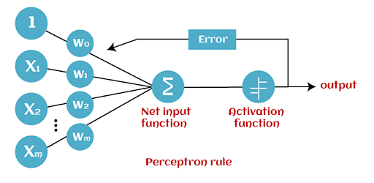
In general, for m inputs, m weights defined initially, and on error after the activation function/step function, update the weights and bias, and reapply the perceptron rule.
Repeat until no error occurs or accuracy is reached

Slide 47
Exercise Problem
Given the activation/Threshold function = 1 when y‘ = y, y’ = w₁x₁ + w₂x_{2.} Find w₁, w₂, for the AND gate function with initial values w₁ =0.3, w₂ = 0.5, and learning rate η = 0.6.

Slide 48
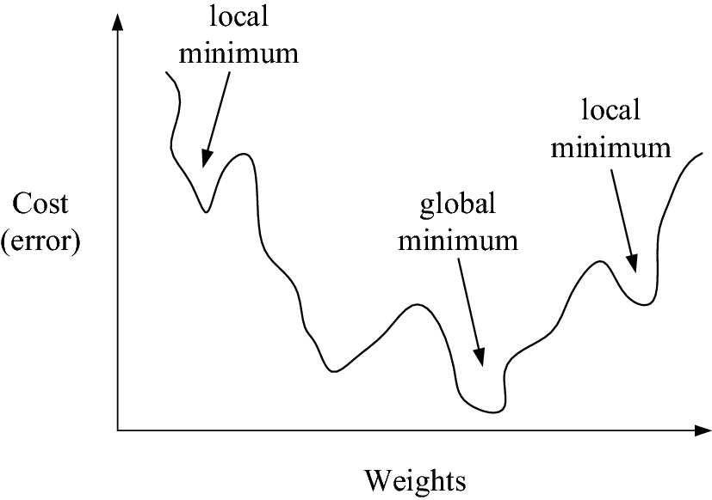
STOCHASTIC APPROXIMATION TO GRADIENT DESCENT
Gradient descent is a strategy for searching through a large or infinite hypothesis space that can be applied whenever
The hypothesis space contains continuously parameterized hypotheses (e.g., the weights in a linear unit), and
The error can be differentiated with respect to these hypothesis parameters.
The key practical difficulties in applying gradient descent are
converging to a local minimum can sometimes be quite slow (i.e., it can require many thousands of gradient descent steps),
if there are multiple local minima in the error surface, then there is no guarantee that the procedure will find the global minimum.

Slide 49
Stochastic gradient descent
One common variation on gradient descent intended to relieve these difficulties is called incremental gradient descent, or stochastic gradient descent.
Whereas the gradient descent training rule presented previously computes weight updates after summing over the training examples in D, stochastic gradient descent approximates this gradient descent search by updating weights incrementally, following the calculation of the error for each individual example.

Slide 50
STOCHASTIC-GRADIET_DESCENT(training_examples, η)
w_{i} ← w_{i} + η(t –o) x_{i}

Slide 51
Error function
In Stochastic gradient descent, a distinct error function defined for each individual training example d is as follows
where t_{d}, and o_{d} are the target value and the unit output value for training example d.
Stochastic gradient descent iterates over the training examples d in D, at each iteration altering the weights according to the gradient with respect to
The sequence of these weight updates, when iterated over all training examples, provides a reasonable approximation to descending the gradient with respect to our original error function .
By making the value of η(the gradient descent step size) sufficiently small, stochastic gradient descent can be made to approximate true gradient descent arbitrarily closely

Slide 52
The key differences between standard gradient descent and stochastic gradient descent are:
Standard(Batch) gradient descent | Stochastic gradient descent
the error is summed over all examples before updating weights | weights are updated upon examining each training example
Summing over multiple examples requires more computation per weight update step and is often used with a larger step size per weight update | often used with a smaller step size per weight update
Since it tries to converge to a single local minima with respect to error, it uses to guide its search | In cases where there are multiple local minima with respect to error, it can sometimes avoid falling into these local minima because it uses the various to guide its search

Slide 53
The modified training rule is like the training rule given by Equation 1
except that as iterate through each training example, update the weight according to equation 2
where t, o, and x_{i} are the target value, unit output, and x_{i} is ith input for the training example.
This training rule in Equation 2 above is known as the delta rule, or LMS (least-mean-square) rule, or Adaline rule, or Widrow-Hoff rule

Slide 54
Remarks
The difference between these two training rules is reflected in different convergence properties.
The perceptron training rule converges after a finite number of iterations to a hypothesis that perfectly classifies the training data, provided
the training examples are linearly separable and
the learning rate η is very small .
The delta rule converges only asymptotically toward the minimum error hypothesis, possibly requiring unbounded time, but converges
regardless of whether the training data are linearly separable or not,
even when training data contains noise.
the learning rate η is very small

Slide 55
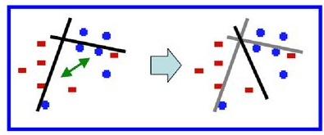
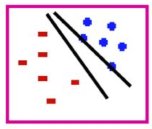
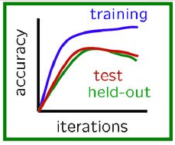
Problems with perceptron
Weight Thrashing: Noise or linearly non-seperable data may cause the weights to thrash and cause models to have undifferentiable errors
Mediocre Generalization: It might find the solution but not the best solution… a barely separating solution
Overtraining (overfitting): more than required training, but doesn’t show any significant performance during testing

Slide 56
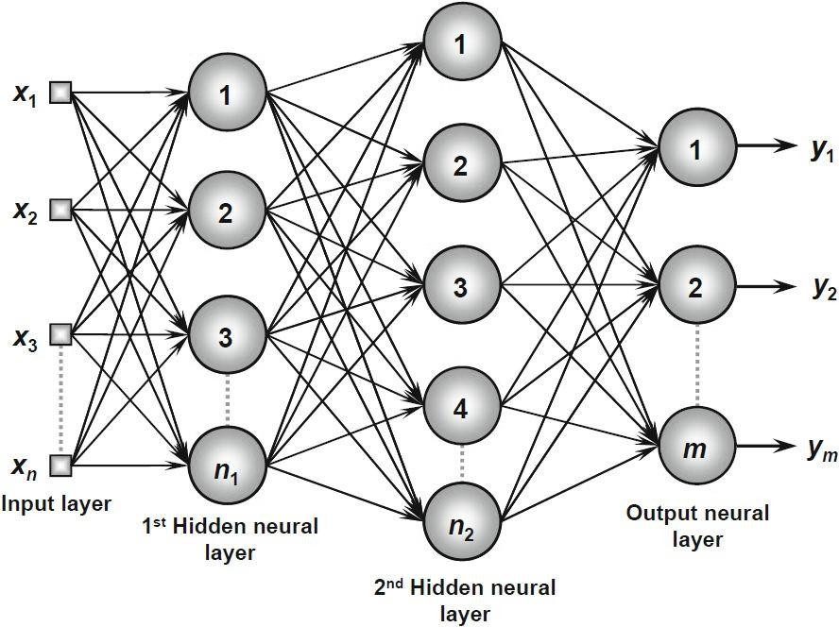
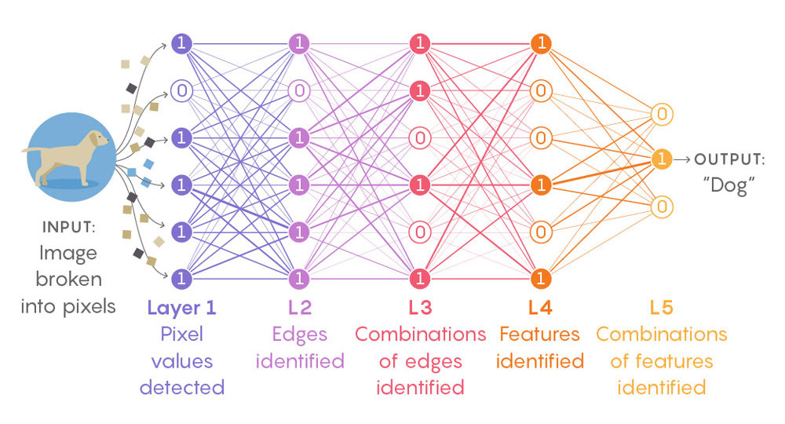
MULTILAYER NETWORKS AND THE BACKPROPAGATION ALGORITHM
Multilayer networks learned by the BACKPROPACATION algorithm are capable of expressing a rich variety of nonlinear decision surfaces

Slide 57
BACKPROPAGATION
The BACKPROPAGATION algorithm learns the weights for a multilayer network, given a network with a fixed set of units and interconnections.
It employs gradient descent to attempt to minimize the squared error between the network output values and the target values for these outputs.
redefine E - sum of the errors over all the network output units ,
where output s is the set of output units in the network, and t_{kd} and O_{kd} are the target and output values associated with the kth output unit and training example d.

Slide 58
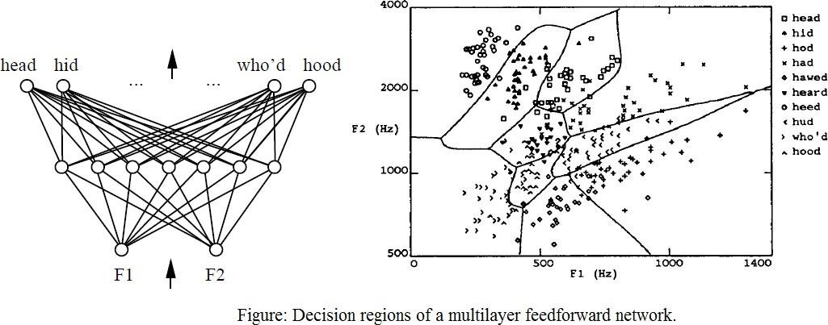
Decision regions of a multilayer feedforward network. The network shown here was trained to recognize 1 of 10 vowel sounds occurring in the context "h_d" (e.g., "had," "hid"). The network input consists of two parameters, F1 and F2, obtained from a spectral analysis of the sound. The 10 network outputs correspond to the 10 possible vowel sounds. The network prediction is the output whose value is highest.
The plot on the right illustrates the highly nonlinear decision surface represented by the learned network. Points shown on the plot are test examples distinct from the examples used to train the network.

Slide 59

A Differentiable Threshold Unit - sigmoid
The sigmoid unit first computes a linear combination of its inputs, then applies a threshold to the result.
The threshold output is a continuous function of its input.
More precisely, the sigmoid unit computes its output o as where
σ is often called the
sigmoid function or,
the logistic function.

Slide 60
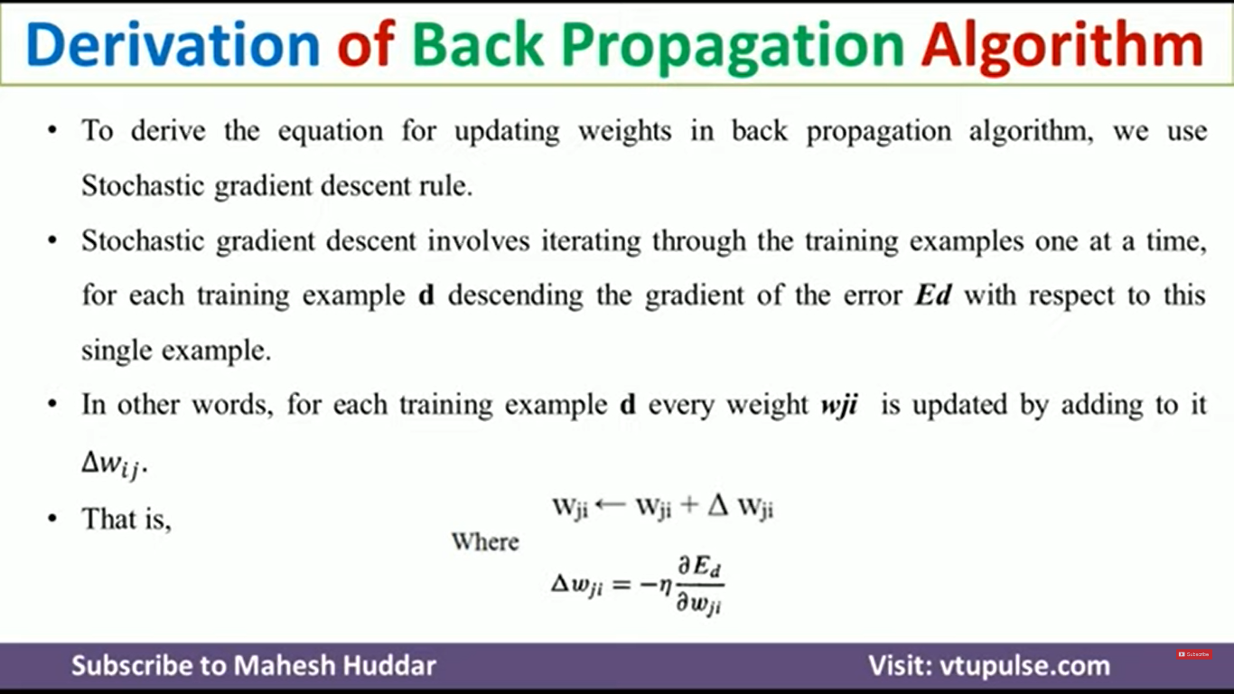

Slide 61
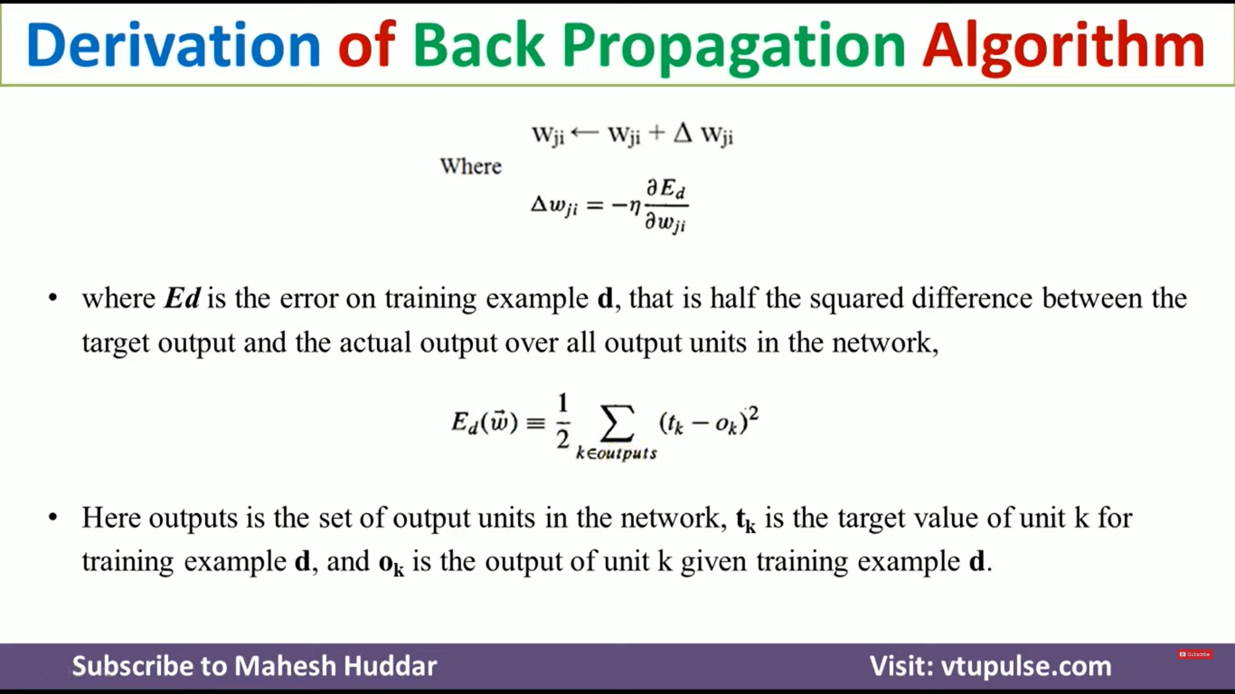

Slide 62
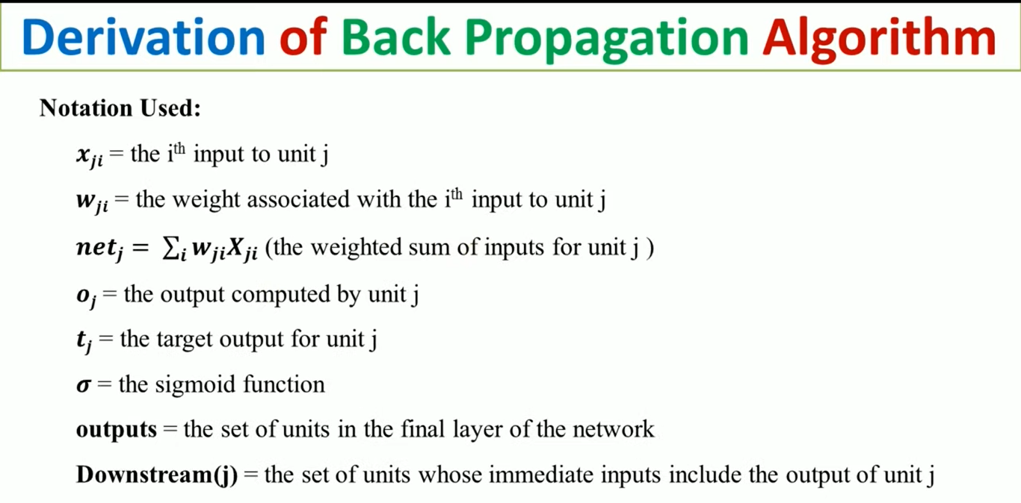

Slide 63
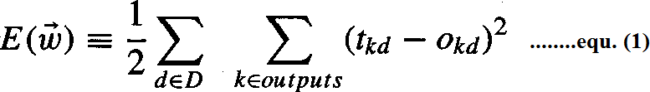
The BACKPROPAGATION Algorithm
The BACKPROPAGATION Algorithm learns the weights for a multilayer network, given a network with a fixed set of units and interconnections. It employs gradient descent to attempt to minimize the squared error between the network output values and the target values for these outputs.
In BACKPROPAGATION algorithm, we consider networks with multiple output units rather than single units as before, so we redefine E to sum the errors over all of the network outputunits.
where, outputs - is the set of output units in the network
t_{kd} and O_{kd} - the target and output values associated with the k^{th} output unit
d - training example

Slide 64
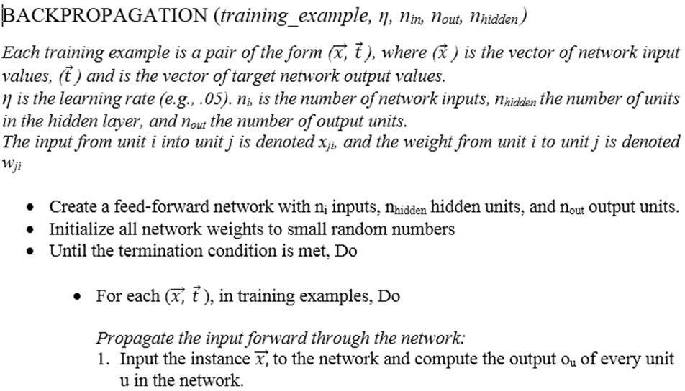

Slide 65
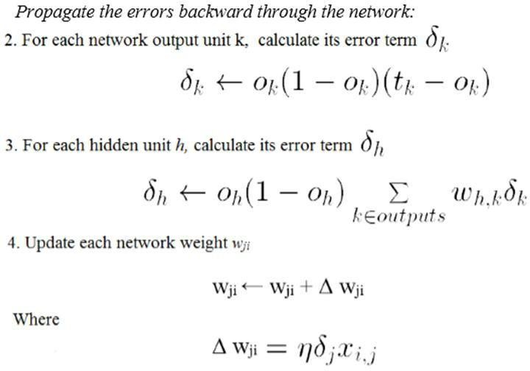

Slide 66
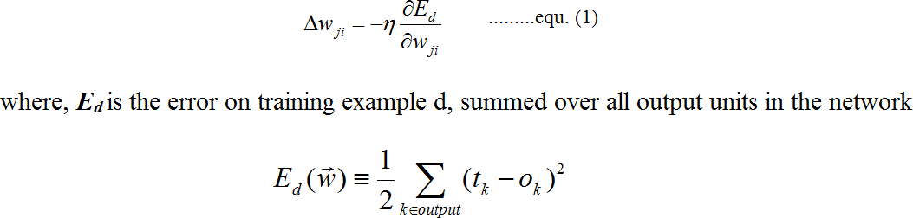
Derivation of the BACKPROPAGATION Rule
Deriving the stochastic gradient descent rule: Stochastic gradient descent involves iterating through the training examples one at a time, for each training example d descending the gradient of the error E_{d} with respect to this single example
For each training example d every weight w_{ji} is updated by adding to it Δw_{ji}
Here outputs is the set of output units in the network, t_{k} is the target value of unit k for training example d, and o_{k} is the output of unit k given training example d.

Slide 67
The derivation of the stochastic gradient descent rule is conceptually straightforward, but requires keeping track of a number of subscripts and variables
x_{ji} = the i^{th} input to unit j
w_{ji} = the weight associated with the i^{th} input to unit j
net_{j} = Σ_{i} w_{ji}x_{ji} (the weighted sum of inputs for unit j )
o_{j} = the output computed by unit j
t_{j} = the target output for unit j
σ = the sigmoid function
outputs = the set of units in the final layer of the network
Downstream(j) = the set of units whose immediate inputs include the output of unit j

Slide 68
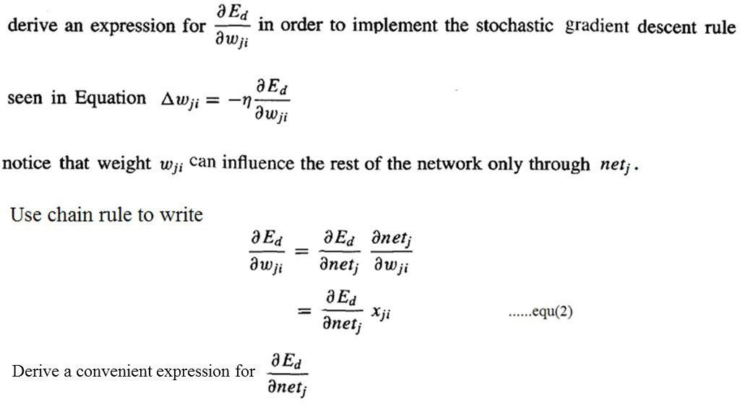
Consider two cases in turn: the case where unit j is an output unit for the network, and the case where j is an internal unit (hidden unit).

Slide 69
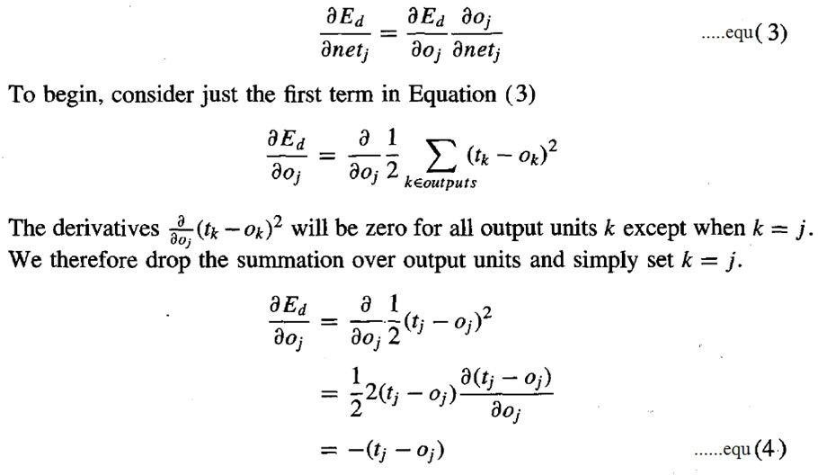
Case 1: Training Rule for Output Unit Weights.
w_{ji} can influence the rest of the network only through net_{j} , net_{j} can influence the network only through o_{j}. Therefore, we can invoke the chain rule again to write

Slide 70
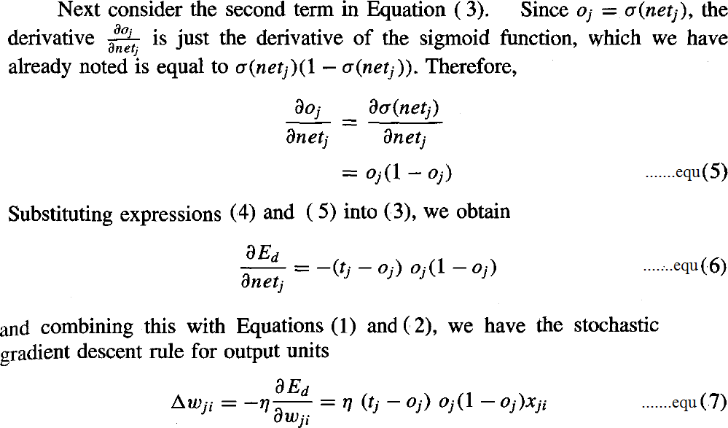

Slide 71
Case 2: Training Rule for Hidden Unit Weights.
In the case where j is an internal, or hidden unit in the network, the derivation of the training rule for w_{ji} must take into account the indirect ways in which w_{ji} can influence the network outputs and hence E_{d}.
For this reason, we will find it useful to refer to the set of all units immediately downstream of unit j in the network and denoted this set of units by Downstream(j).
net_{j} can influence the network outputs only through the units in Downstream(j).
Therefore, we can write

Slide 72
